Slide 1
Figures
Fiber-Microbiome Study

Slide 2
Questions to be addressed
What is the effect of Prebiotin vs placebo on the gut microbiome (controlling for, age, ethnicity)
Stability over time - pre vs post intervention (Johnson paper – Fig. 6E)
Diversity over time - pre vs post intervention
Alpha – FIG 1
Beta – FIG 2/3
Phylogenetic - FIG 4
What is the effect of Prebiotin vs placebo on anthropometrics (controlling for diet, age, ethnicity)- Did the intervention mitigate excess weight gain? NO EFFECTS --> Table 3
BMI
Lean mass
Fat mass
Weight, overall
Weight change
What is the effect of Prebiotin vs placebo on measures of stress
What is the correlation between the microbiome and stress? Table 3
What is the effect of Prebiotin vs placebo on clinical variables (blood measures - lipids, PYY) Table 3

Slide 3
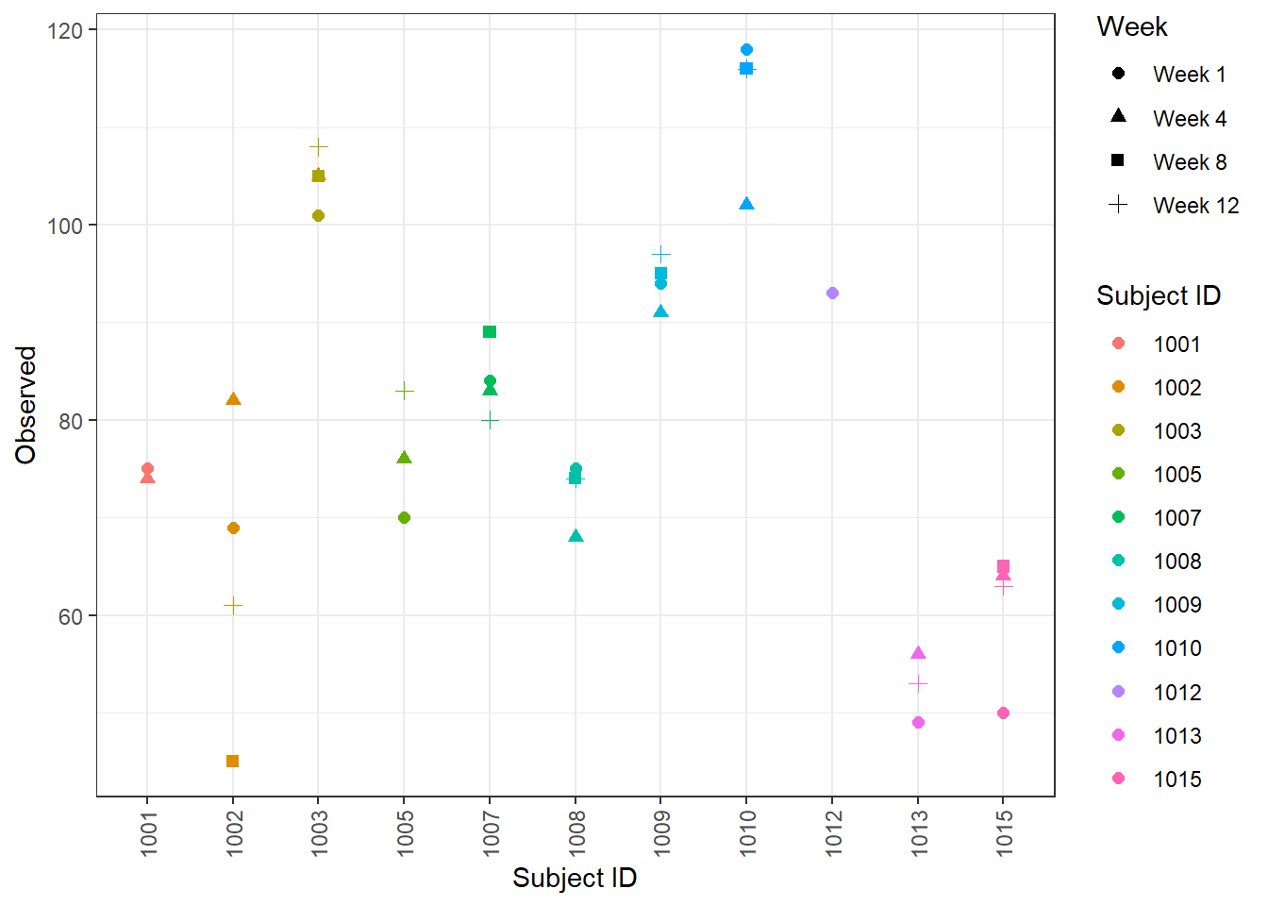
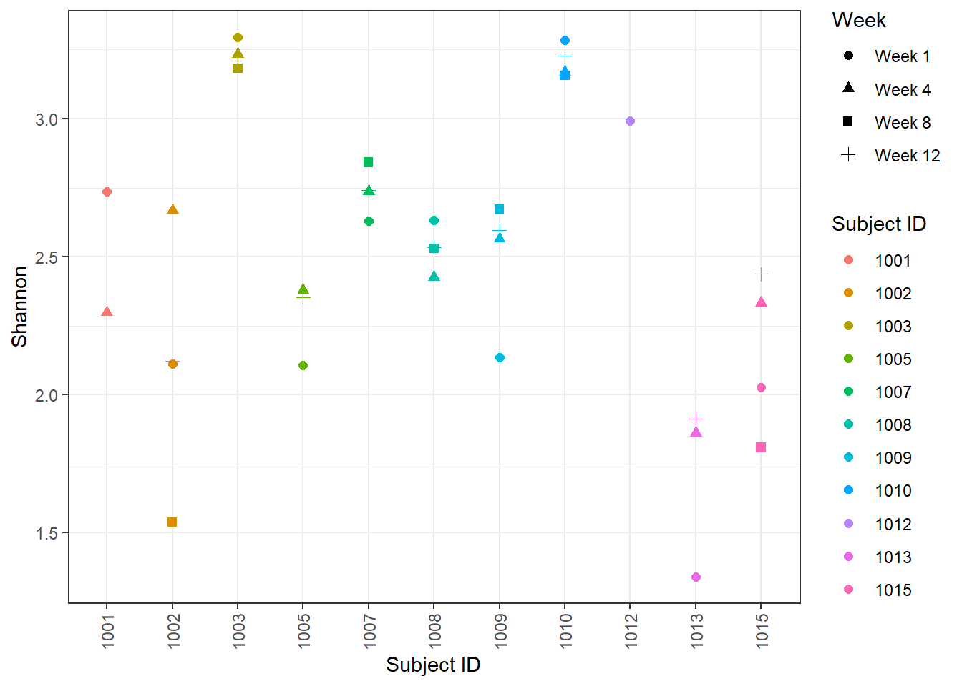
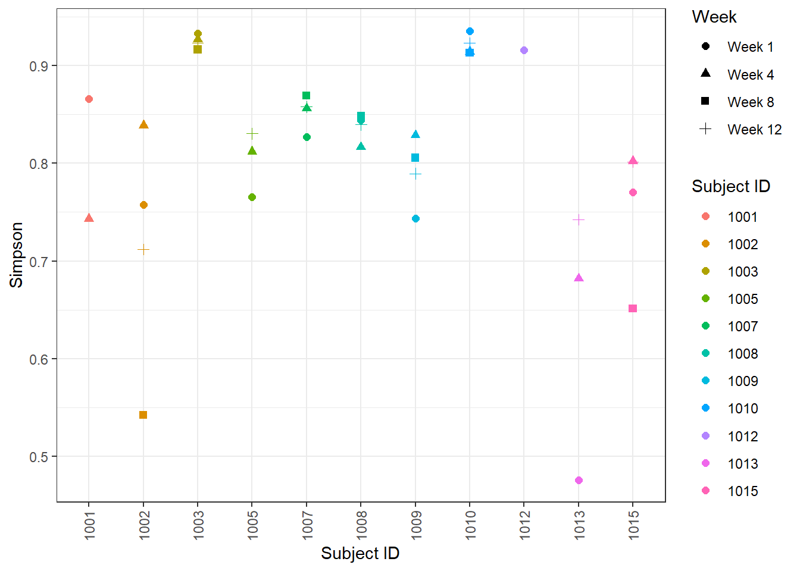
Fig. 1 Change in alpha diversity is not affected by dietary fiber intervention

Slide 4
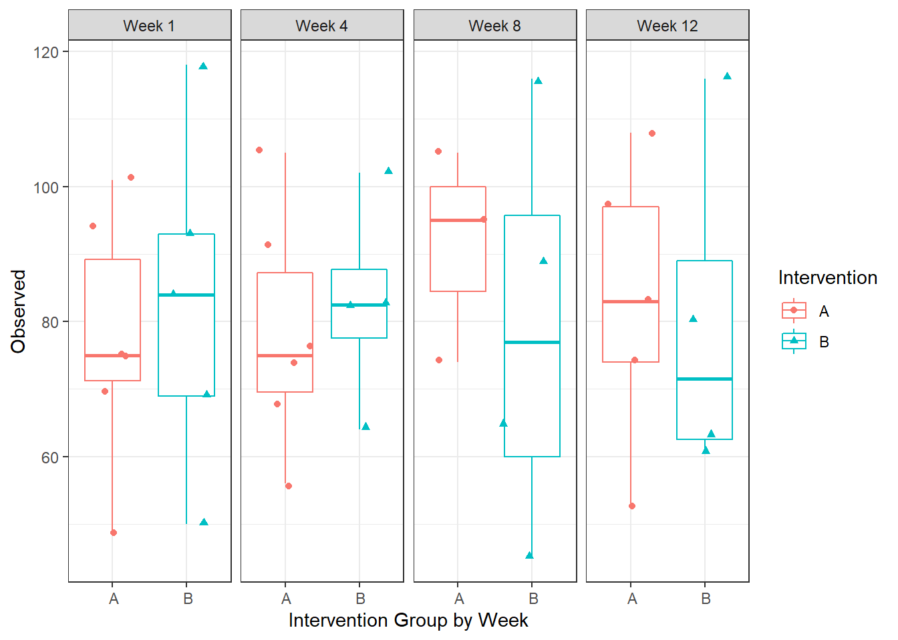
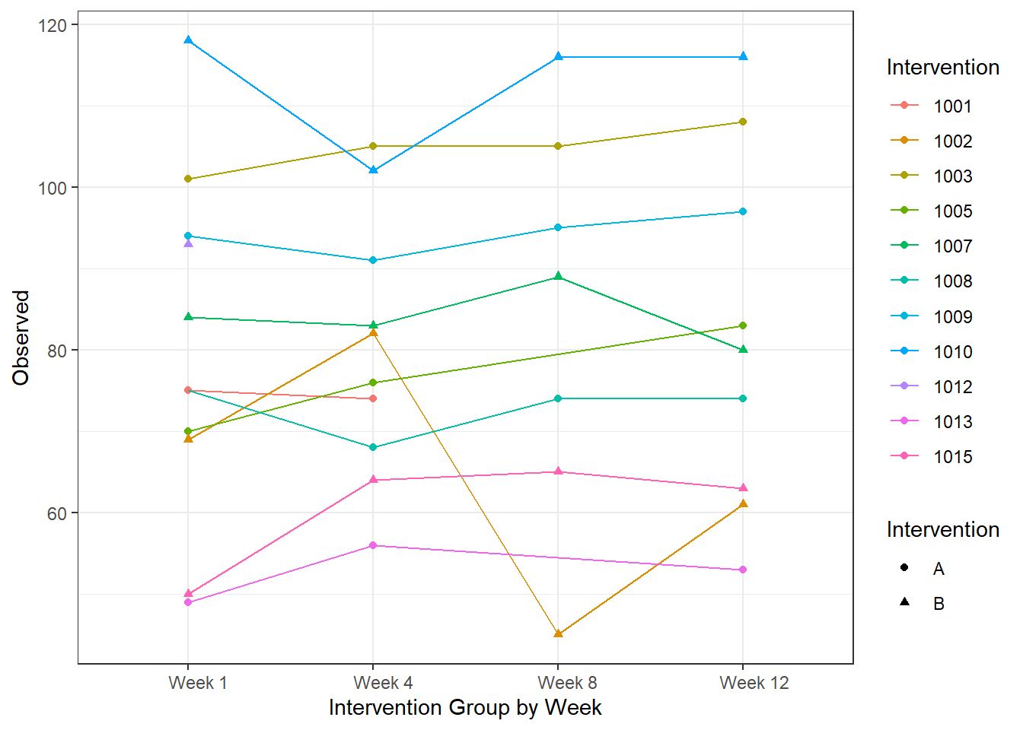
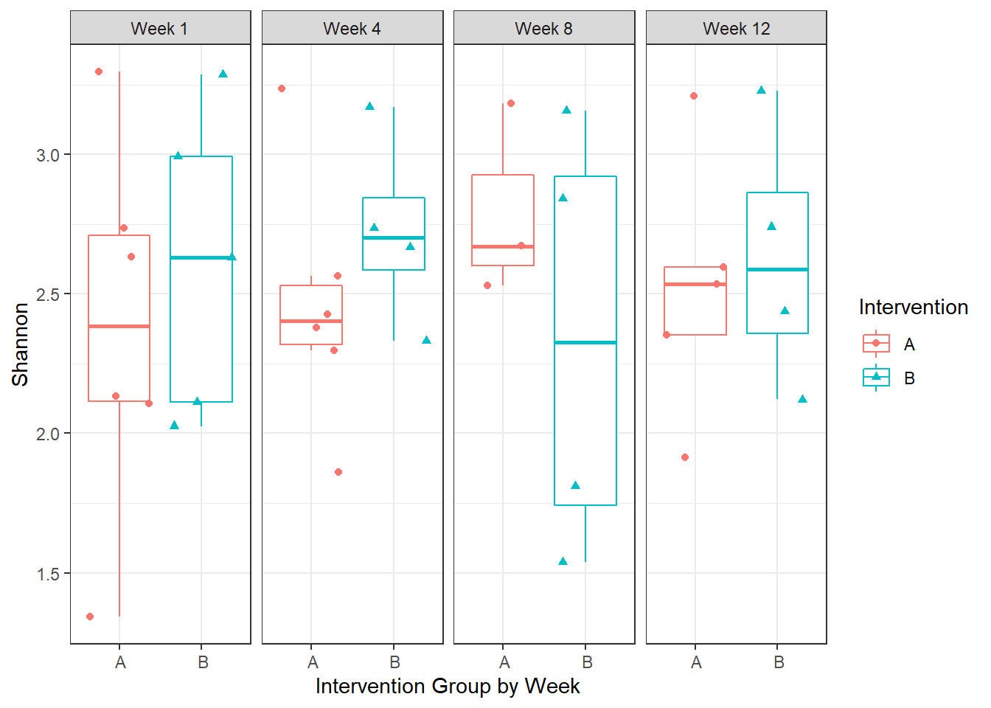
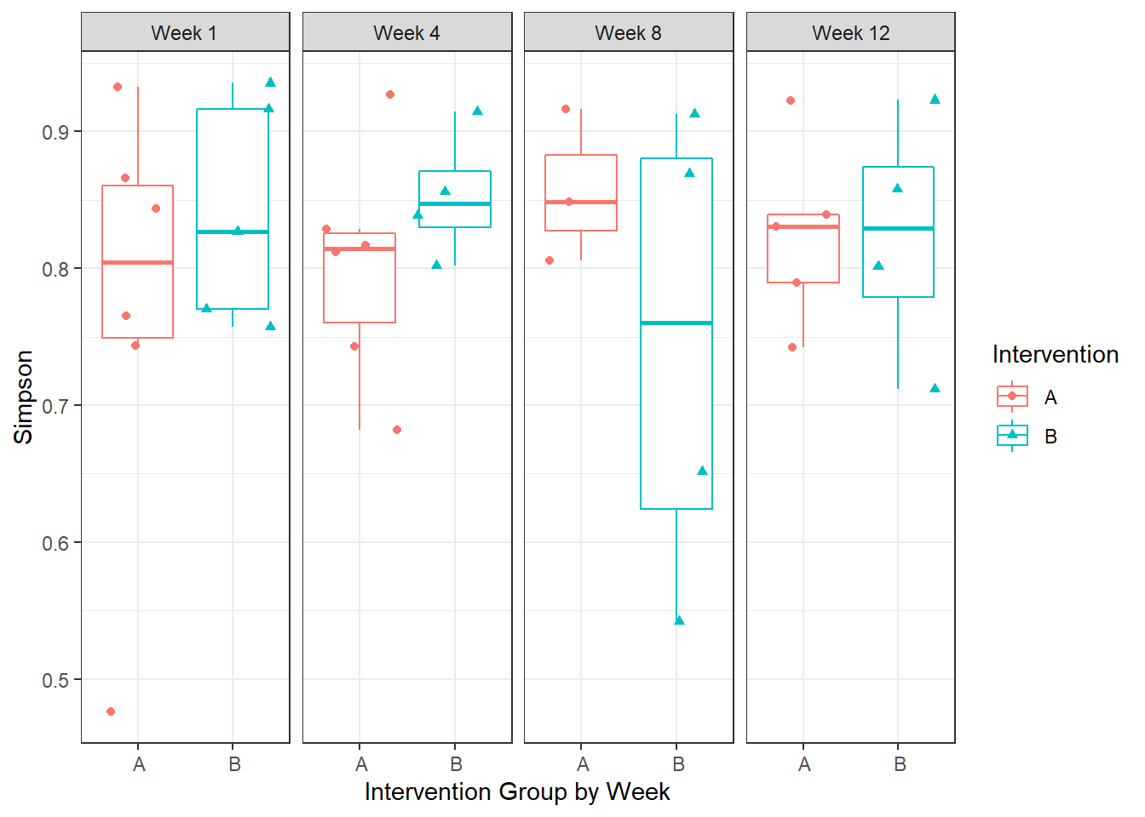
This should be two boxes by intervention
Need corresponding line plots for each alpha div. measure like for Observed

Slide 5
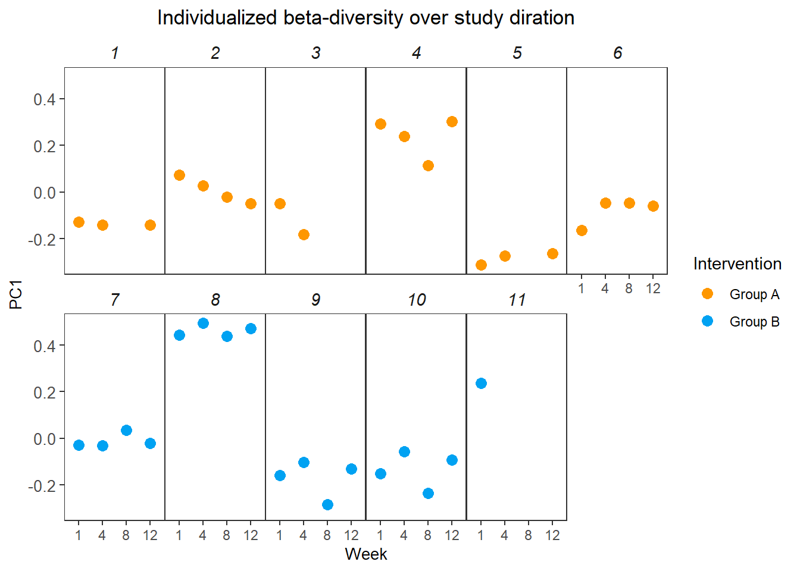
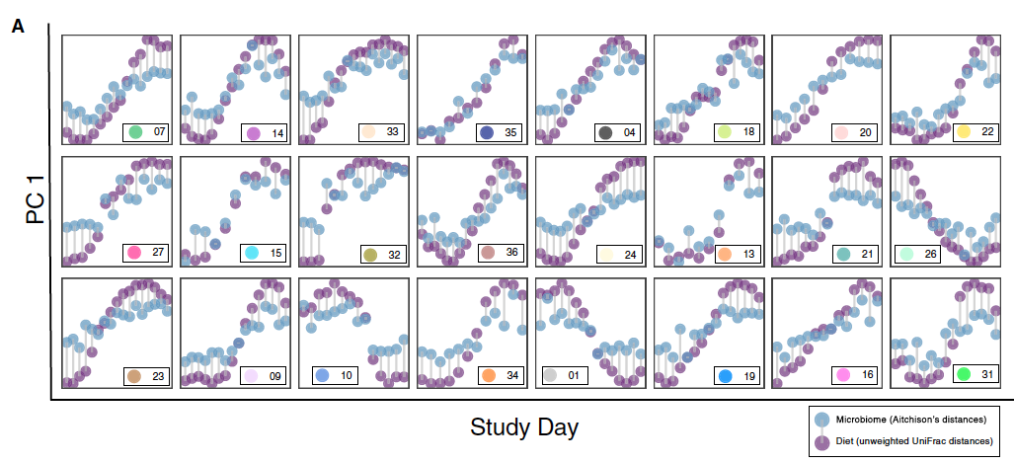
FIGURE 2. Individualized beta-diversity over the duration of the study
NOT ACTUAL FIG – place holder

Slide 6
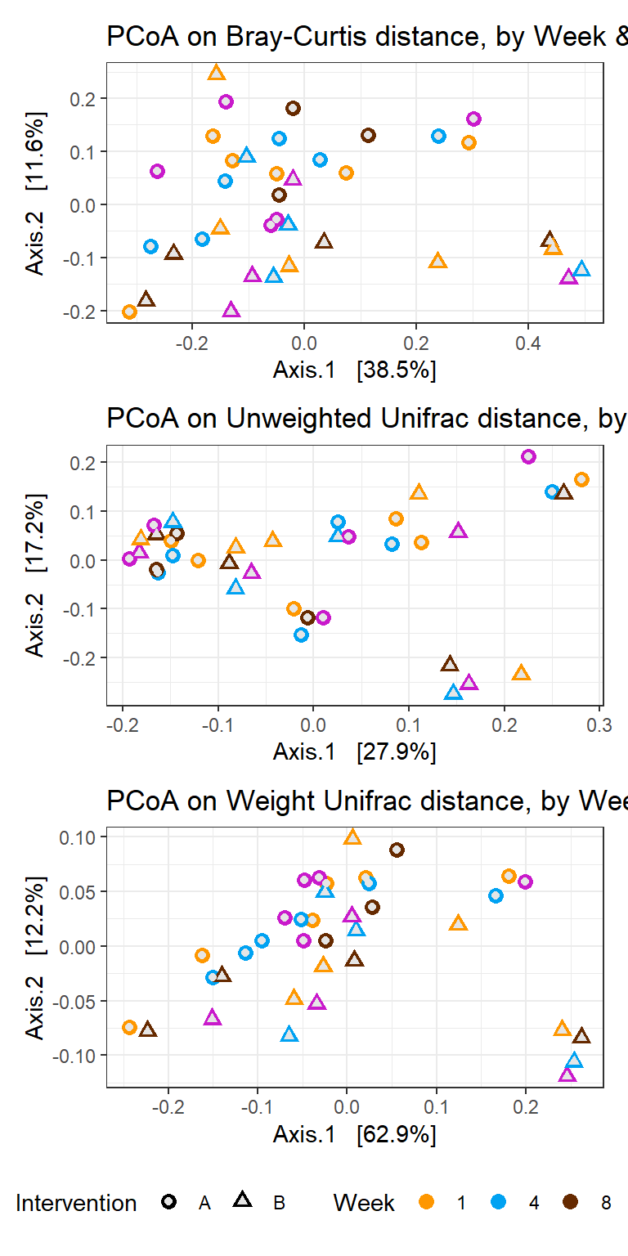
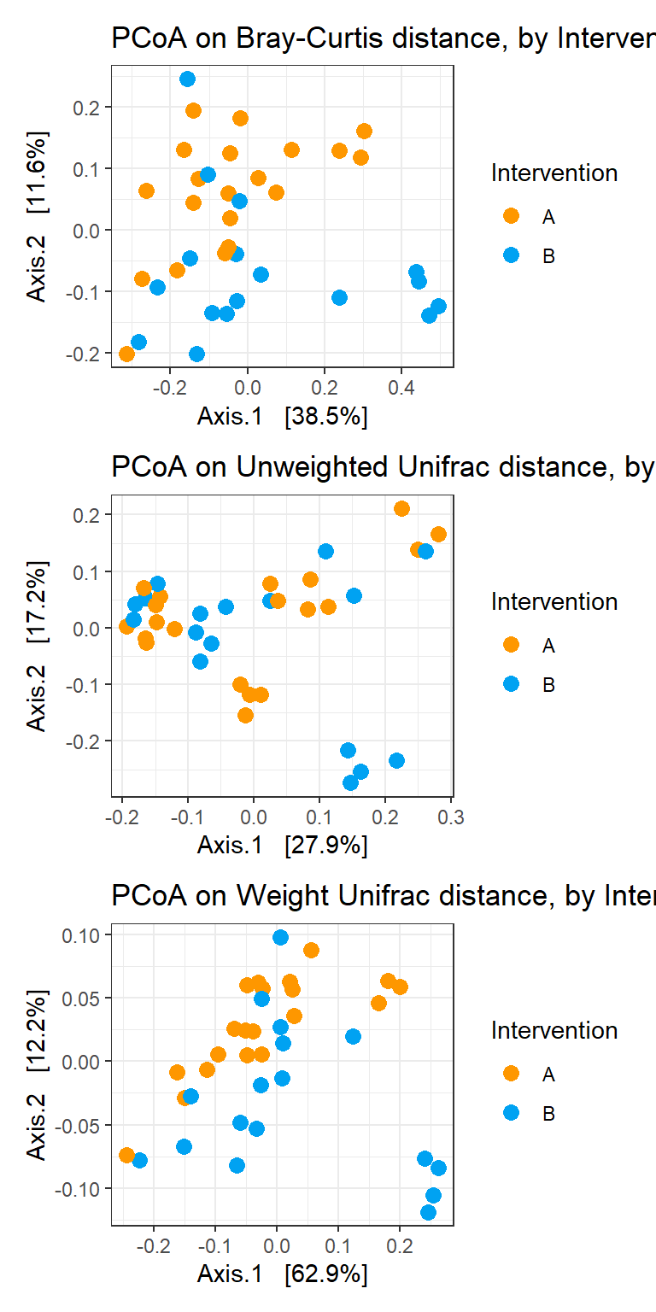
FIGURE 3?. No effect of intervention on beta diversity during the study period

Slide 7
Fig 4
Notes:
FIGURE 1. Individualized microbial response to dietary fiber intervention or placebo and dietary variation

Slide 9
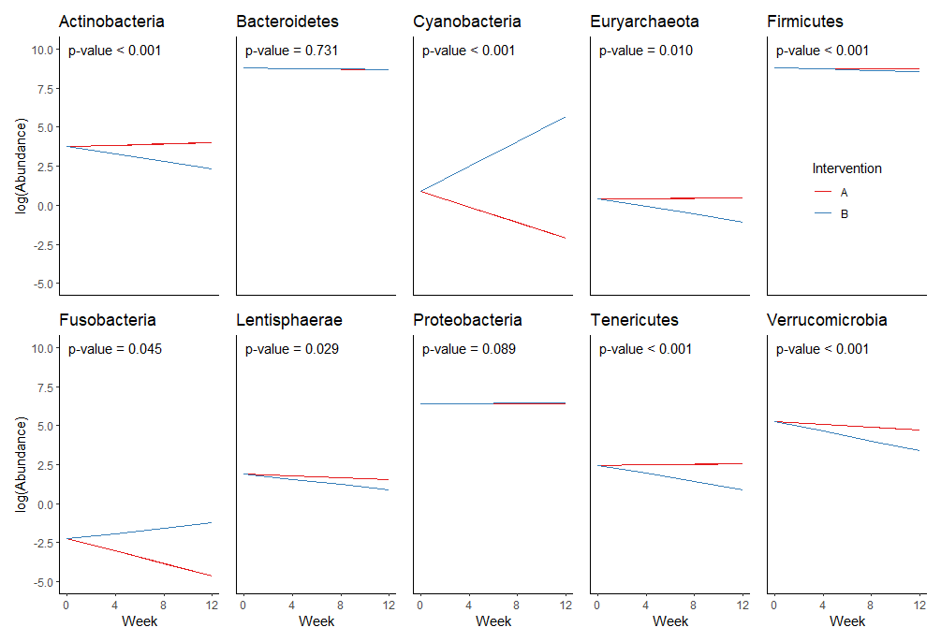

Slide 10
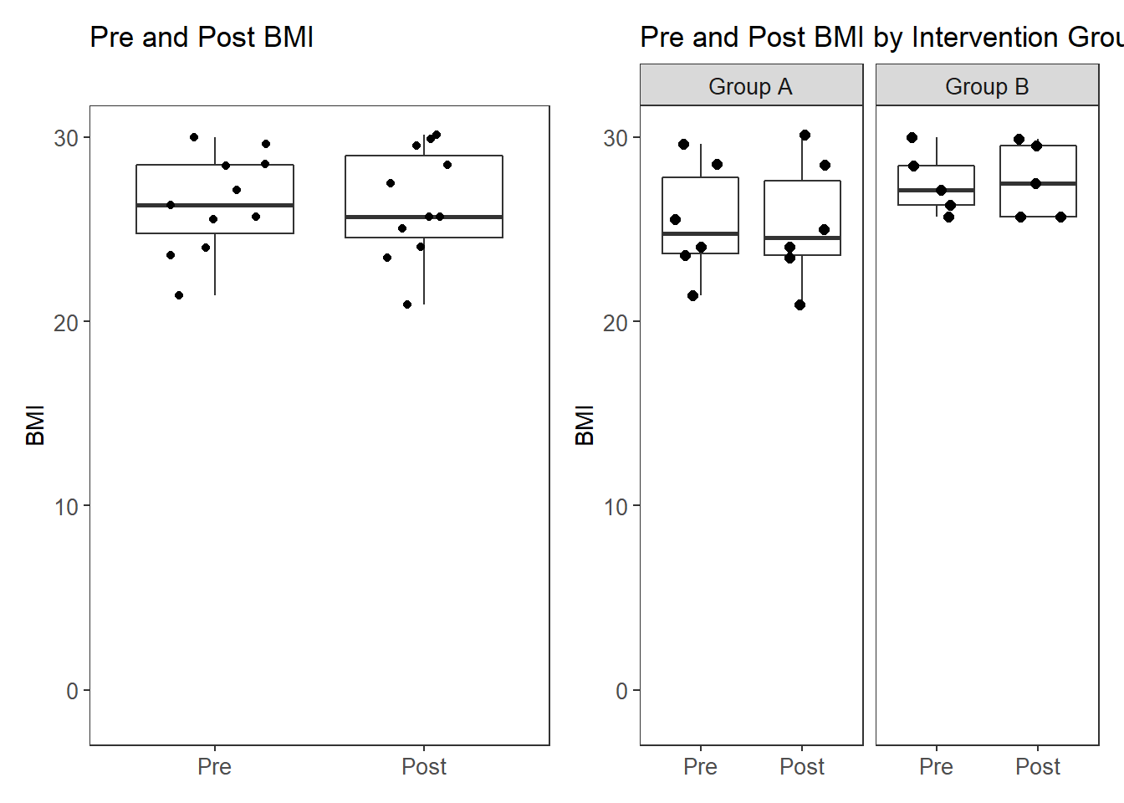
No effect of Prebiotin vs Placebo on change in BMI
Would also like to see a line plot with connected dots for each individuals by group, so we can see if there was and significant weight gain or loss

Slide 11
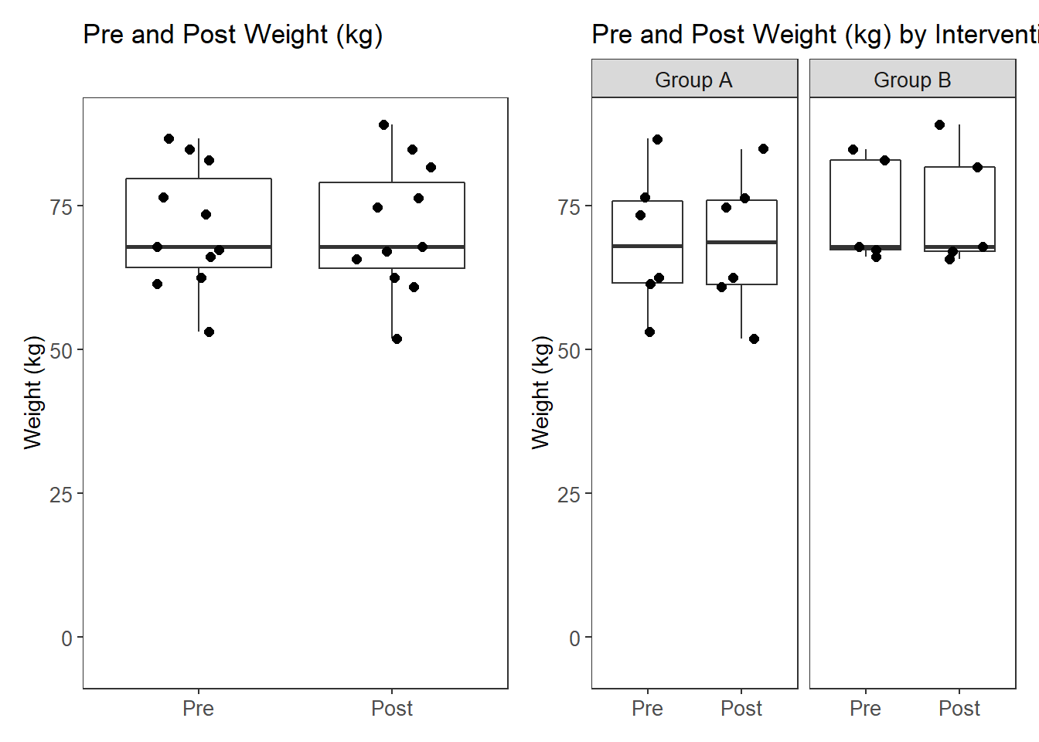
No effect of Prebiotin vs Placebo on change in weight (kg)
Would also like to see a line plot with connected dots for each individuals by group

Slide 12
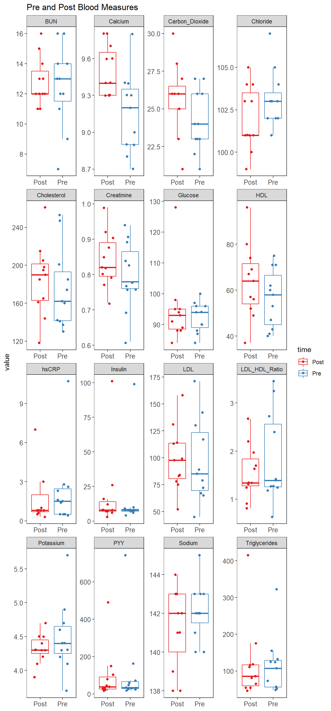

Slide 13
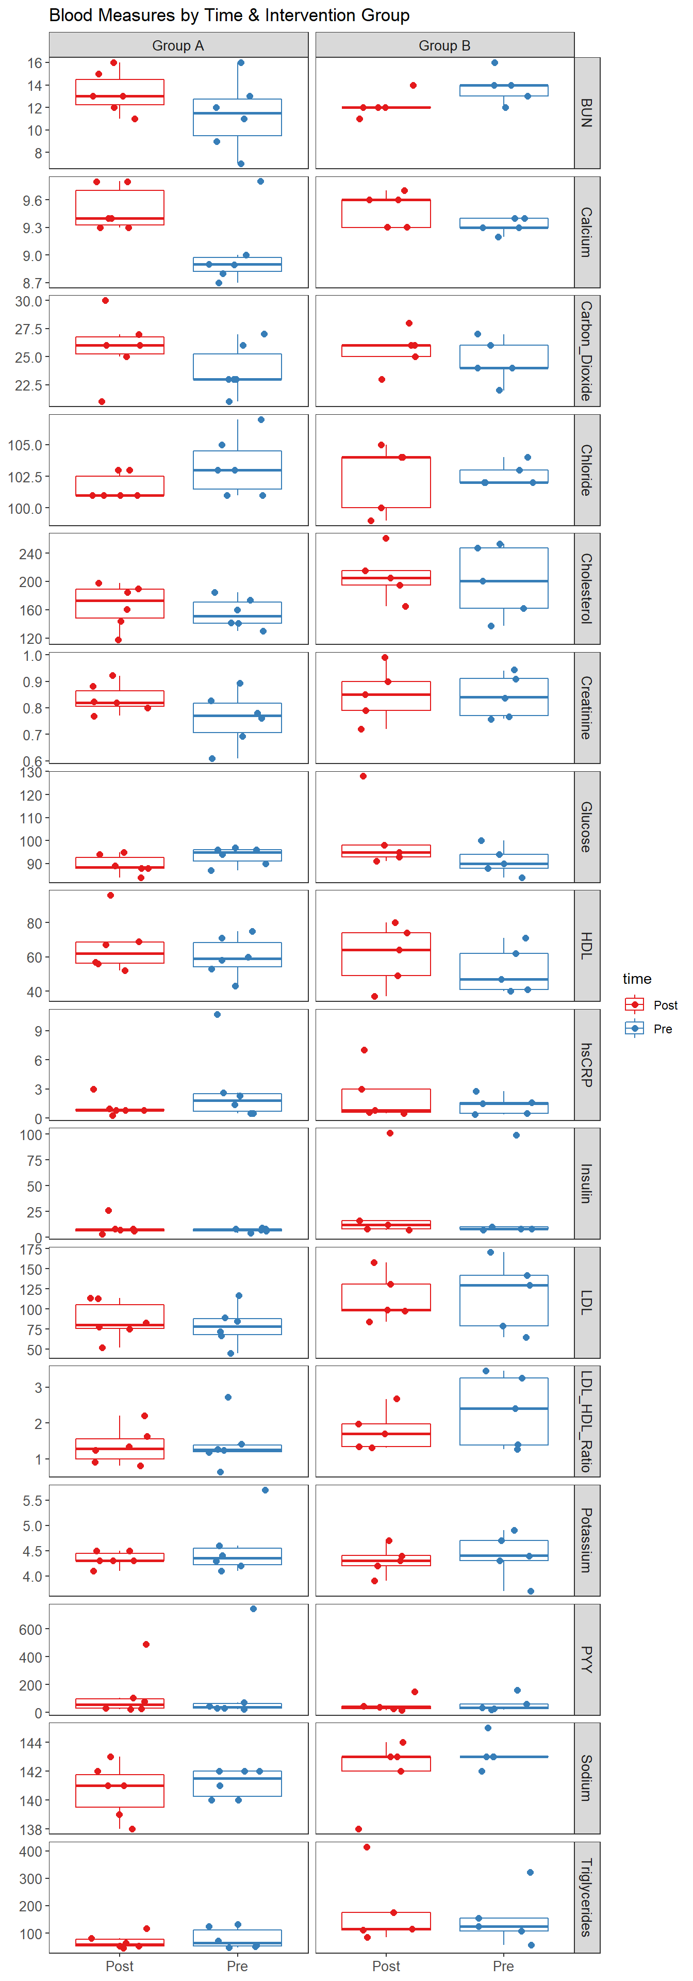

Slide 14
Tables

Slide 15
Tables 1 & 2
 | Intervention | Placebo
ASA24
Baseline | 3 | 6
Week 4 Week 8 Week 12 | 2 1 0 | 5 3 2
FFQ (DHQII)
One time only | 2 | 7
Stool Sample
Baseline Week 4 Week 8 Week 12 | 4 3 3 3 | 7 7 4 6
Add baseline FFQ scores to table 1

Slide 16
Table 3 – Changes in Anthropometrics and Clinical Biomarkers between groups
Need to split up by group (placebo vs. intervention) and apply statistical values
*controlling for age, ethnicity, stress score – need to HEI scores to control vars

Slide 18
Supplemental Table 1
Baseline |  |  | 1.5 Year Follow Up
Variables | Mean | Standard Deviation | Mean | Standard Deviation
Weight | 76.92 | 17.61 | 3.02 | 4.99
Waist | 34.90 | 4.00 | 0.87 | 2.95
DXA | 26.33 | 8.79 | 3.35 | 2.51
Fat weight | 44.69 | 16.62 | 9.27 | 6.45
Lean weight | 127.52 | 32.82 | -3.50 | 9.95
Visceral fat | 328.24 | 144.84 | 54.67 | 65.35
Total cholesterol | 183.04 | 29.28 | 8.00 | 27.95
LDLC | 111.21 | 24.94 | 7.60 | 23.51
HDLC | 55.88 | 14.80 | -5.82 | 5.77
Triglycerides | 95.92 | 52.53 | 17.30 | 59.64
Glucose | 89.92 | 7.58 | 9.95 | 13.74
Preliminary Findings: Findings from an on-going study by co-investigator, Dr. Grandjean, indicate that over a short 18-month period, residents experience an increase in body weight, fat mass, waist circumference and loss of lean mass. Also of concern is that their lipid profiles change unfavorably and glucose levels increase. Please see table 1 for details.

Slide 19
Diet Data Analysis 8/21/19

Slide 20
Total KCAL Intake (ASA24)

Slide 21
Overall Macronutrient Percentages
Notes:
*Recall 4 only has 2 participants

Slide 22
Individual Percentages of Each Nutrient

Slide 23
Outliers
1007 Recall 3
1013 Recall 2

Slide 24
Outliers Cont.

Slide 25
Fiber Outliers
1002
Recall 1

Slide 26
Individual Fiber Intake Without Supplement

Slide 27
Fiber Supplement Compliance
*Note: Only participants that received actual supplements are displayed in this chart. Participants receiving placebo were not included.

Slide 28
Individual Fiber With Supplement
*Note: Fiber1002 did not complete ASA_24 after Recall 1, so fiber supplement could not be added. 1007, 1010, and 1015 show supplemental fiber intake. 1003, 1005, 1008, 1009, 1013 received placebo, so no supplemental fiber was added to their data.

Slide 29
Discussion
Cookies were not accounted for
Some participants logged the cookies. Others did not
Those that logged the cookies logged them all differently
How would we like to handle this?
Most participants given supplement were very compliant with the exception of 1007 over the last 4 weeks
Most of placebo group appeared to be fairly noncompliant during the last 4 weeks with the exception of 1003
Supplement did appear to make a difference in overall fiber consumption in test participants with the exception of 1007, who was noncompliant during the last 4 weeks, and 1002, who did not complete enough ASA_24 to analyze.

